Slide 1
Chatbot Therapy
Name: Le Duc Nghia ID:14706
Major: Computer Science Engineering Superviser: Dr. Ngoc Tran Hong
Co-Supervisor: Dr. Dinh Quang Vinh

Slide 2






Table of contents
01
02
03
Introduction
Motivation
Idea
Conclusion
Model
05
04
Data preparation
06

Slide 3

01
Introduction

Slide 4

Two columns
Purpose
Create a chatbot that can recognize emotions through facial expressions, voice, and some psychology quests to understand your current emotions in order to provide therapeutic methods and empathy to help you overcome daily life issues with practical advices.

Slide 5
02
Motivation

Slide 6



Motivation
Vietnam
Developed countries
General Motivation

Slide 7

Motivation
Develop countries
Psychology plays a vital role in understanding mental health. Developed countries like the United States, Europe, and Japan prioritize mental health development to improve their citizens' quality of life.

Slide 8

Motivation
Vietnam
In Vietnam, psychology has been a distant concern during the past 10-20 years of focusing on economic growth. However, at the present with the improved economy, there is now a growing interest in mental health among the population.

Slide 9

Motivation
General motivation
This chatbot supports healthcare professionals in providing mental health therapy, improving quality of life, and promoting awareness of the value of mental well-being for a happier society.

Slide 10

03
Idea

Slide 11


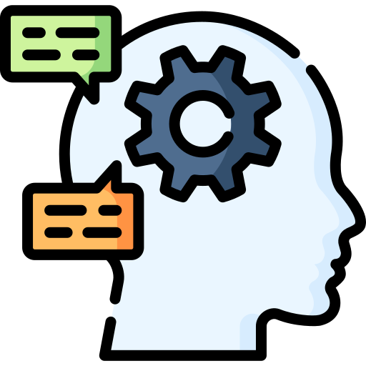

Idea
Facial Emotion Recognition
Voice Emotion Recognition
Natural Language Preprocessing
Positive solutions

Slide 12
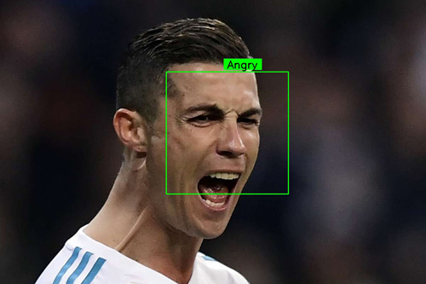

Idea
Facial Emotion Recognition
Facial Emotion Recognition: Recognizing several emotions:
Angry, Disgust, Fear, Happy, Sad, Surprise,
Neutral

Slide 13
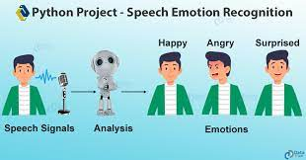

Idea
Voice Emotion Recognition
Voice Emotion Recognition: Recognizing several emotions:
Angry, Disgust, Fear, Happy, Sad, Surprise,
Neutral

Slide 14
Idea
Natural Language Preprocessing
Understanding human languages and Psychology concepts

Slide 15
Idea
Positive solutions
Able to understand people emotion deeply and give some positive feedbacks

Slide 16
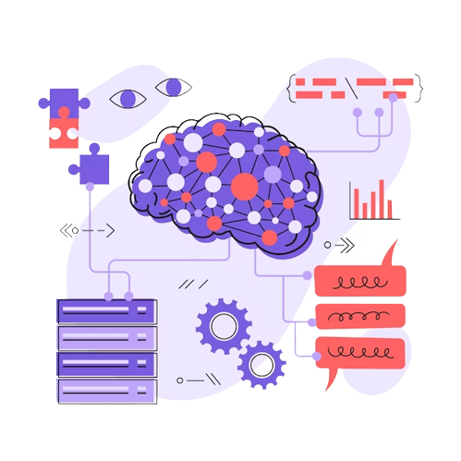
04
Modeling

Slide 17



Modeling

Slide 18

Modeling
Hugging Face
Hugging Face is a company and open-source community focused on NLP and machine learning. They are known for their Transformers library, which offers pre-trained models for various NLP tasks. Hugging Face provides user-friendly tools and resources to help developers build and deploy advanced NLP models.
https://huggingface.co/

Slide 19
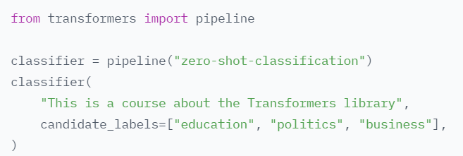
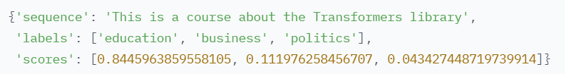
Modeling
Hugging Face
Application:
Zero-shot classification NLP

Slide 20
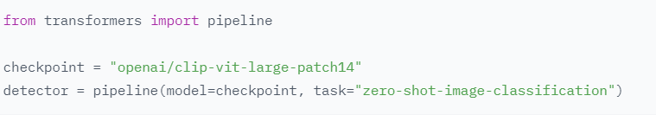
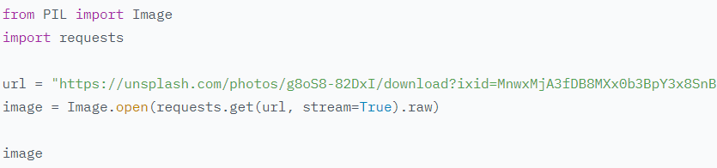
Modeling
Hugging Face
Application:
Zero-shot classification Image

Slide 21

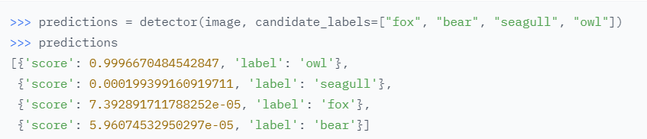
Modeling
Hugging Face
Application:
Zero-shot Image Classification

Slide 22

Modeling
Hugging Face
Zero-shot classification Image with 6 emotions:
Happy
Sad
Digust
Fear
Pleasant-Suprised Happy

Slide 23
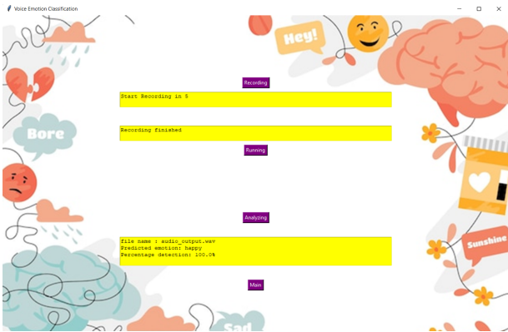
Modeling
Kaggle
Audio Emotion classification
Happy
Sad
Digust
Fear
Pleasant-Suprised Happy

Slide 24
Modeling
FlowiseAI is an open source UI visual tool that helps in building customized LLM (Language Learning Models) flow using LangchainJS.

Slide 25

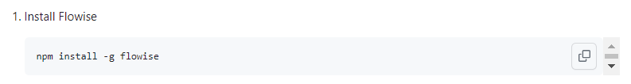
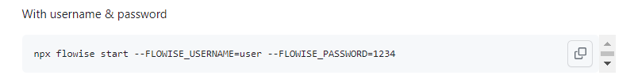
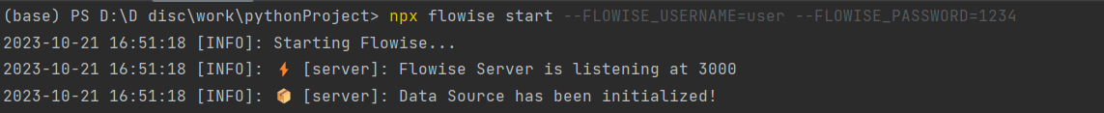

Modeling
FlowiseAI
How to setup:
Open the AI model
https://github.com/FlowiseAI/Flowise
https://localhost:3000

Slide 26
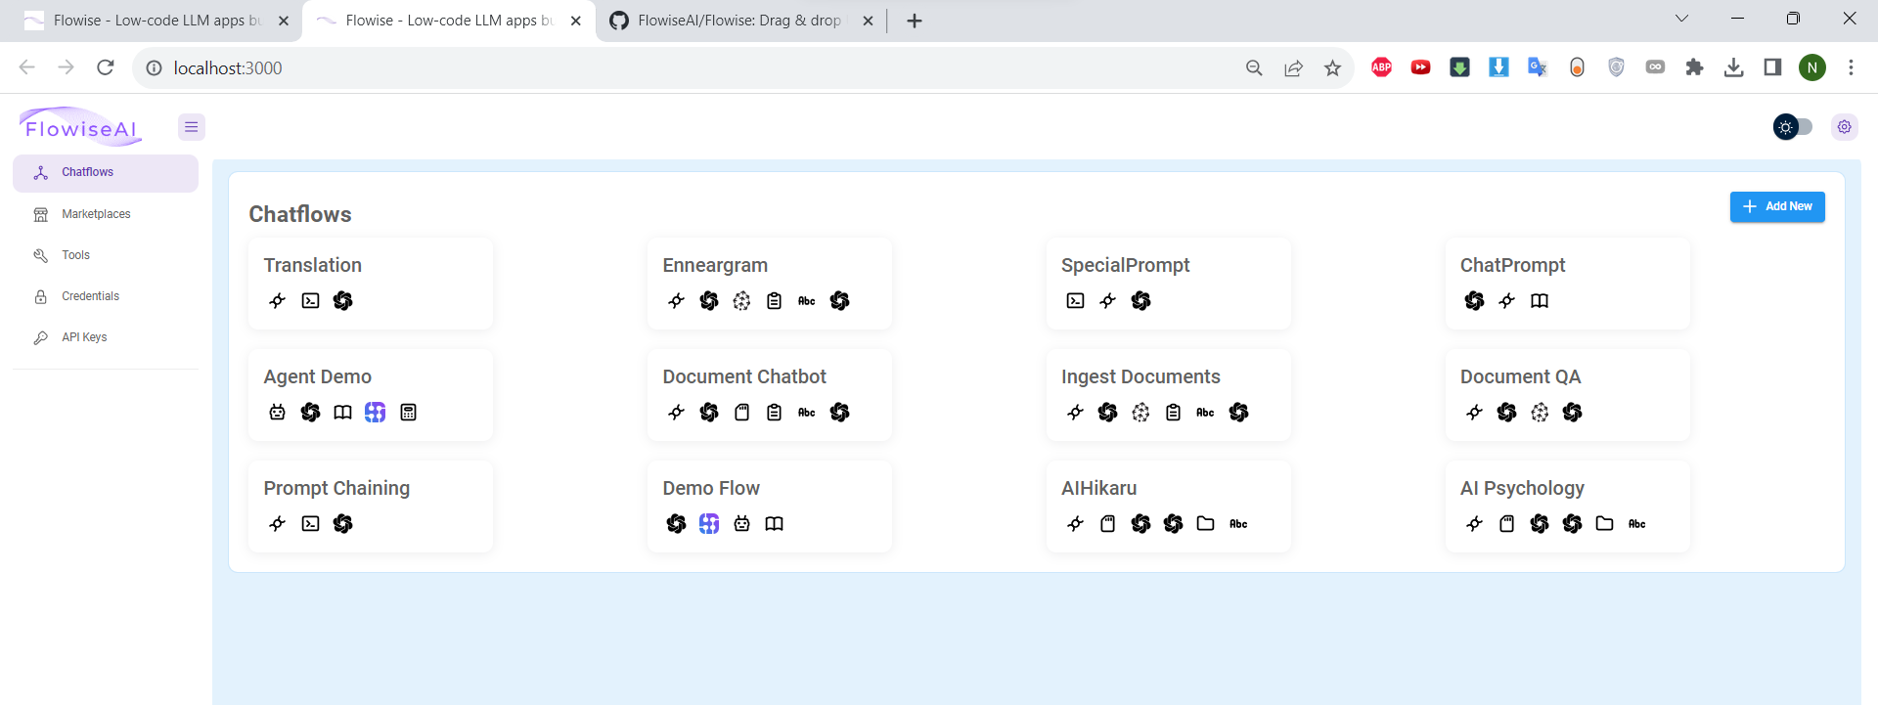
Modeling
FlowiseAI

Slide 27
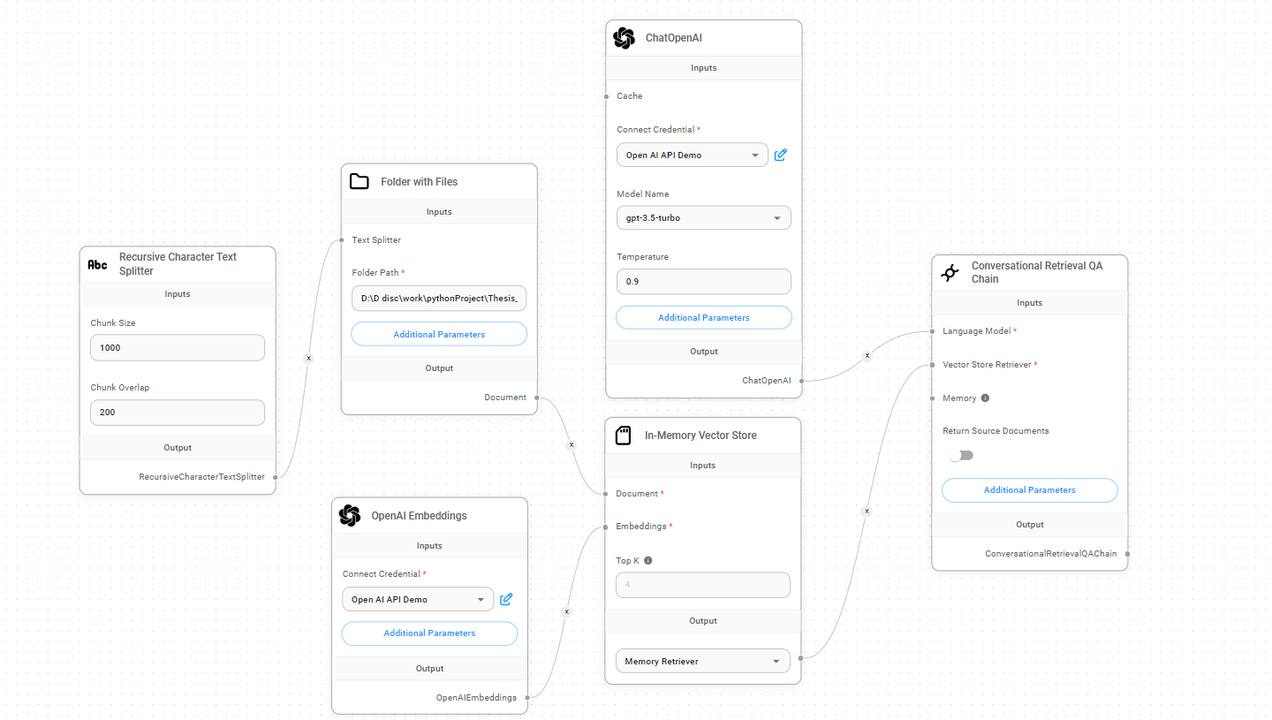
Modeling
FlowiseAI

Slide 28
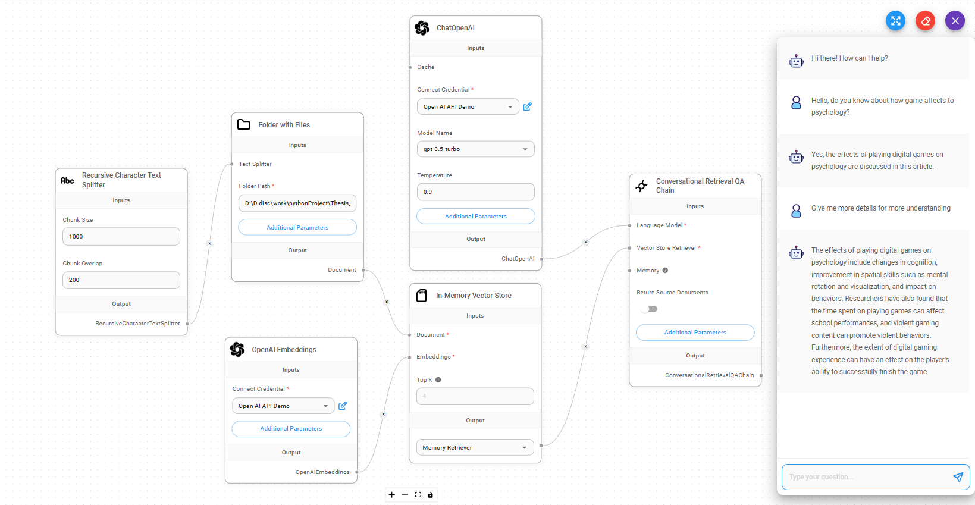
Modeling
FlowiseAI

Slide 29

Data Preparation
05
Data preparation with 6 topics:
Developmental Psychology
Social Psychology
Educational Psychology
Depression Psychology
Anxiety Psychology
Behavioral Psychology

Slide 30

Data Preparation
Developmental Psychology

Slide 31
Data Preparation
Developmental Psychology
Developmental psychology focuses on the study of human development across the lifespan, from infancy to old age.

Slide 32
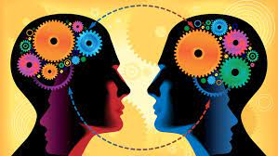
Data Preparation
Social Psychology

Slide 33
Data Preparation
Social Psychology
Social psychology explores how individuals' thoughts, feelings, and behaviors are influenced by the presence of others and the social environment.

Slide 34
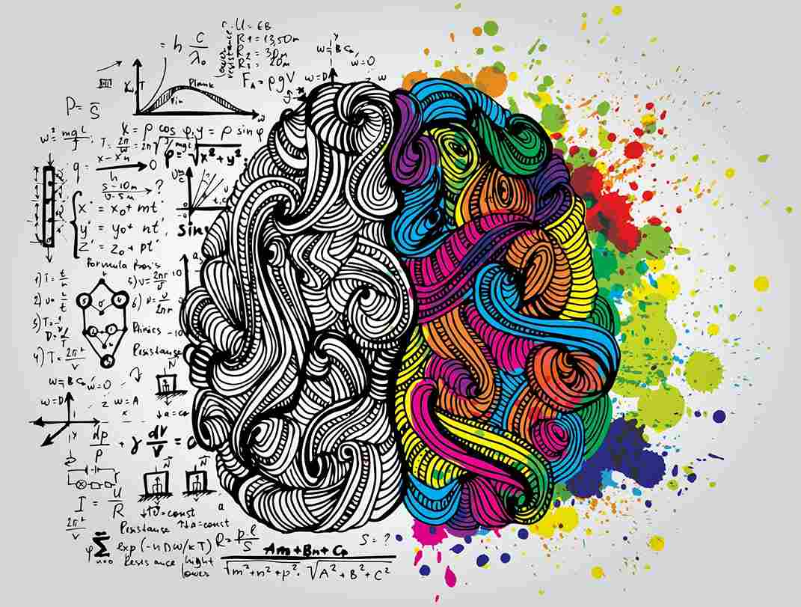
Data Preparation
Educational Psychology

Slide 35
Data Preparation
Educational Psychology
Educational psychology focuses on understanding how people learn and develop in educational settings.

Slide 36

Data Preparation
Depression Psychology

Slide 37
Data Preparation
Depression Psychology
Depression psychology involves the study and treatment of depression, a mood disorder characterized by persistent feelings of sadness, hopelessness, and a lack of interest or pleasure.

Slide 38

Data Preparation
Anxiety Psychology

Slide 39
Data Preparation
Anxiety Psychology
Anxiety psychology focuses on understanding and treating anxiety disorders, which involve excessive and persistent worry, fear, and anxiety that significantly interfere with daily functioning.

Slide 40

Data Preparation
Behavioral Psychology

Slide 41
Data Preparation
Behavioral Psychology
Behavioral psychology, also known as behaviorism, emphasizes the study of observable behaviors and the environmental factors that influence them.

Slide 42

06
Conclusion

Slide 43
Thanks!
Do you have any questions?

